Slide 1
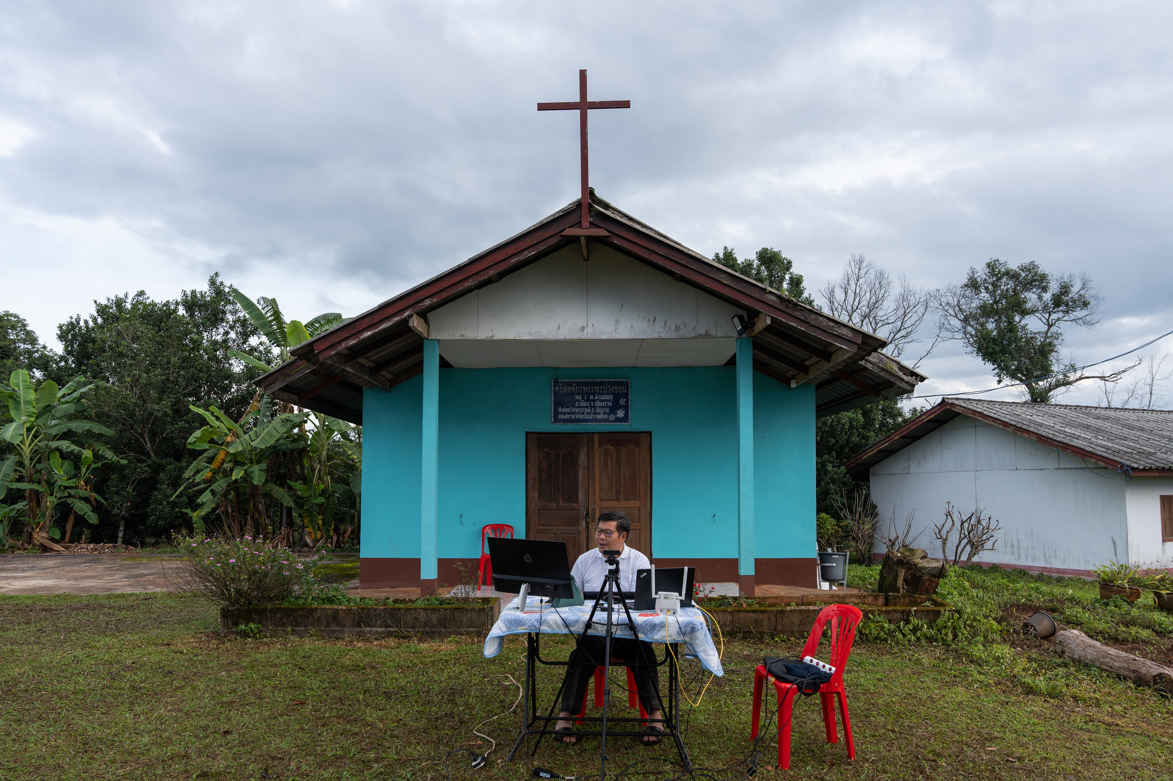
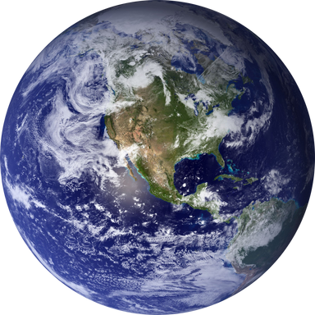

GL BAL DAY OF PRAYER FOR MEDIA
SUNDAY 27 OCTOBER 2024
Pray for
  FEBC broadcasters and Christian media professionals, that God would give them the wisdom to craft messages that speak to hearts and minds, declaring His majesty.
  Christians in media globally, that they would stand firm in their Biblical convictions, courageously presenting the truth with righteousness and integrity.
  All broadcasters and their teams worldwide, for personal strength, professional integrity, and support as they face the pressures of their roles.

